Slide 1
Visual Symptom Checker
Reinforcement Learning
Zahra Hamedi, Vinzenz Uhr
11.01.2024

Slide 2
Project Description
Doctors often ask their patients a series of questions in order to narrow down the set of plausible conditions matching the observed symptoms. By asking relevant questions, they can diagnose their patients more efficiently.
Project: Visual Symptom Checker that combines a pre-trained Convolutional Neural Network (CNN) with a Reinforcement Learning agent as a Question Answering model.

Slide 3
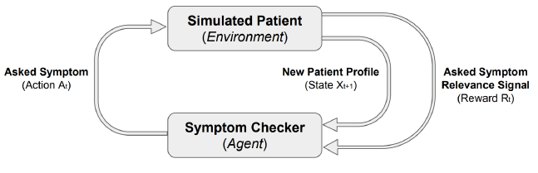
MDP Formulation
The Visual Symptom Checker operates as a Markov Decision Process (MDP), facilitating patient interaction by asking questions about symptoms and the patient’s responses.
Figure: The agent-patient interaction in an MDP

Slide 4
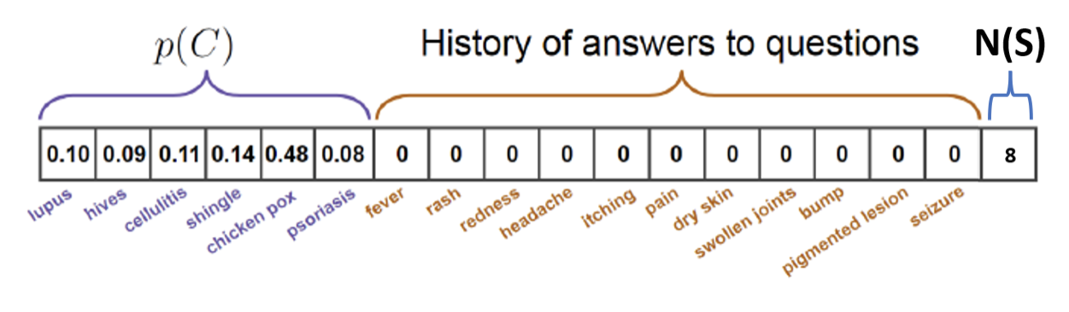
MDP Formulation
States
The state x is a composite of the patient's historical responses to the questions about symptoms and the prior probability distribution of diseases obtained from the pre-trained CNN as proposed in the original Paper
We’ve additionally added the number of symptoms asked.
Figure: State design
Notes:
Asked symptoms: 0 corresponds to a not yet asked symptom, 1 means the patient has the symptom and -1 means that the patient does not have the symptom.
number of asked symptoms -> to distinguish states where the same symptom is asked multiple times.

Slide 5
MDP Formulation
Actions
Each action in the action space corresponds to selecting a specific symptom to ask the patient

Slide 6
MDP Formulation
Transition Probability
When the agent asks the simulated patient if he has a symptom, the patient answers with yes or no. The patient does this based on the conditional probabilities p(s|c) in HealthKnowledgeGraph.csv. The simulated patient answers s by generating a random number k from a uniform distribution between 0 and 1. If k <= p(s|c), the answer is yes, and no otherwise.

Slide 7
MDP Formulation
Reward
Reward is posterior p(c*|S) as proposed in original Paper
Agent started asking symptoms which are not related to the correct condition, so it doesn’t reduce the posterior
𝑝(𝐶∣𝑆)∝𝑃(𝑆∣𝐶)∗𝑝(𝐶)
Our approach to this problem is the addition of the conditional probabilities p(s|c*) instead of their multiplication
To penalise multiple queries for the same symptom, we have introduced a penalty after each step.
Notes:
After each asked symptom which is correlated to the correct condition c* the conditional probability p(s|c*) will be multiplied to the current posterior. Because 0 <= p(s|C) <= 1, a correlated Symptom will usually decrease the posterior probability p(c*|S). Symptoms which are not correlated are skipped and therefore don’t decrease the posterior.

Slide 8
Dataset
Slake dataset consisting of 642 annotated medical images, covering 12 diseases and 39 organs
However, for only five of these diseases ('Pneumothorax', 'Pneumonia', 'Pleural Effusion', 'Cardiomyopathy', 'Lung Cancer'), symptom probabilities are available in the 'HealthKnowledgeGraph.csv.'
diseases are specifically related to lung and heart conditions.
this project focuses on 111 chest images from the Slake dataset
Train-Test-Split using stratification and an 80/20 split

Slide 9
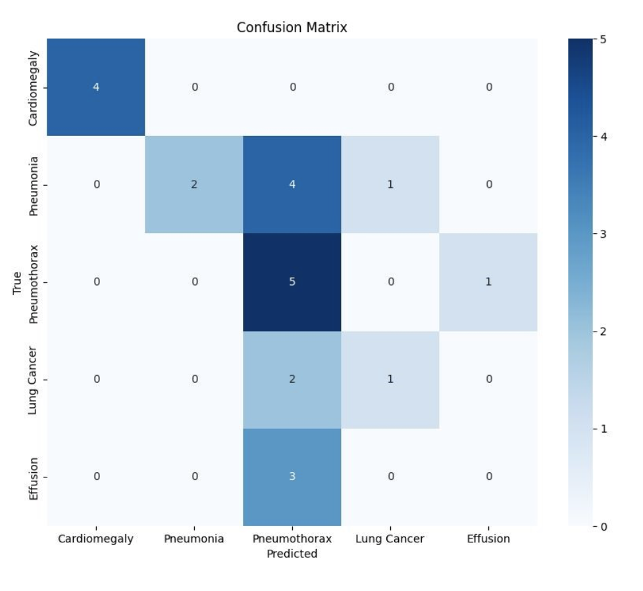
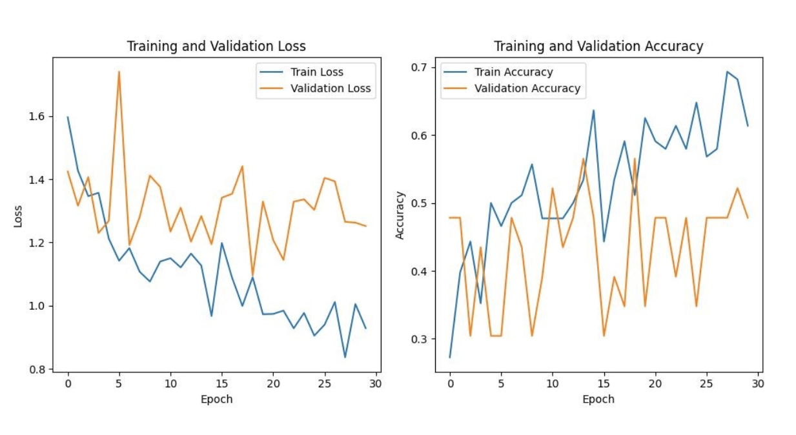
CNN
AlexNet convolutional neural network (CNN) architecture to achieve probability distributions of the five target diseases

Slide 10

RL environment
Deep Q-Network (DQN) to estimate action-value function Q
Proprietary Env Class for MDP environment
Figure: DQN Architecture

Slide 11
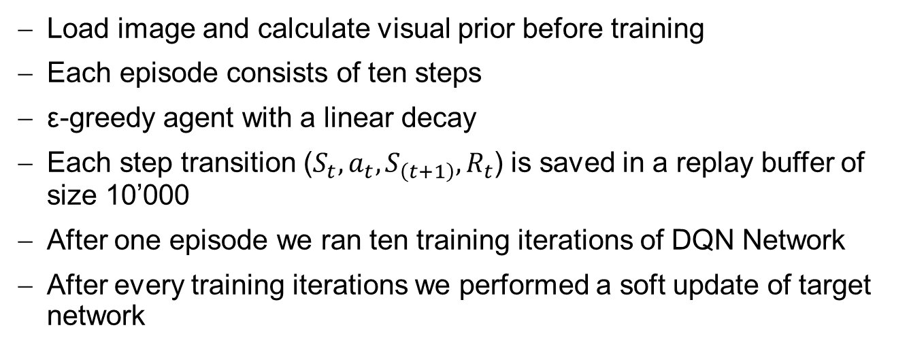
RL Training
Load image and calculate visual prior before training
Each episode consists of ten steps
ε-greedy agent with a linear decay
Each step transition ($S_{t},a_{t},S_{\left(t+1\right)},R_{t}$) is saved in a replay buffer of size 10’000
After one episode we ran ten training iterations of DQN Network
After every training iterations we performed a soft update of target network

Slide 12
RL Training
Batch of 128 Transitions
Clipping Gradient norms to 100
Trying different epsilon decays

Slide 13
RL Results
Tensorboards metrics
Training loss, norm of the gradients
Reward at each step, final reward at the end of the episode, total reward per episode (sum of all rewards)
Top-1 accuracy, top-2 accuracy, top-3 accuracy and the number of selected actions during evaluation
Final evaluation with “multiplication-model” and “addition-model”
Notes:
The rewards are measured on the training set and the top-K accuracy and the number of actions on the validation set.
We did out final evaluation with two models: One uses our reward approach with punishments after each action and addition instead of multiplication to combine the conditional probabilities. We call it “Addition-Model”. The second model uses the reward from the paper with multiplication and without punishments. We call this “Multiplication-Model”.

Slide 14
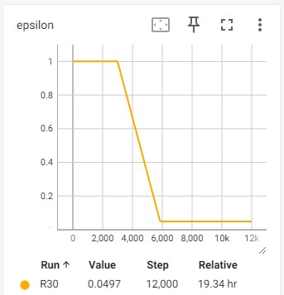
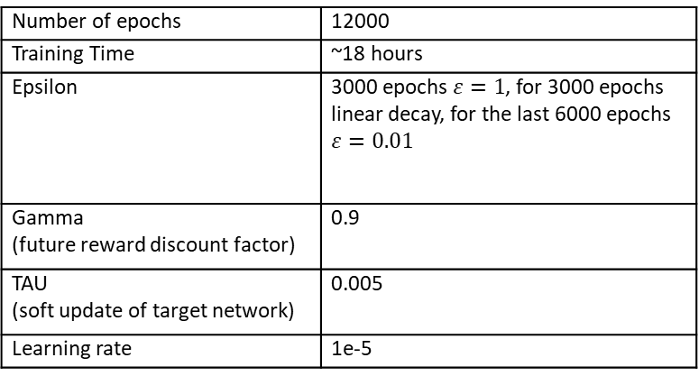
RL Results
Parameters
Number of epochs | 12000
Training Time | ~18 hours
Epsilon | 3000 epochs$ε=1$, for 3000 epochs linear decay, for the last 6000 epochs $ε=0.01$
Gamma (future reward discount factor) | 0.9
TAU (soft update of target network) | 0.005
Learning rate | 1e-5
Table: Used parameters for both models
Figure: Value curve of epsilon

Slide 15
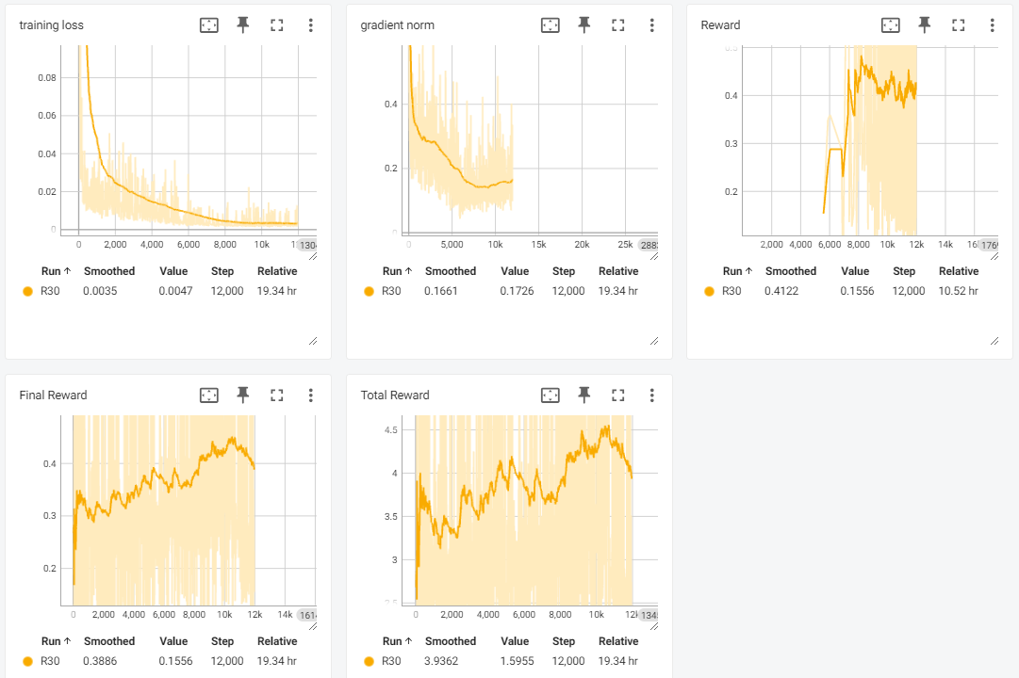
RL Results
Multiplication-Model

Slide 16
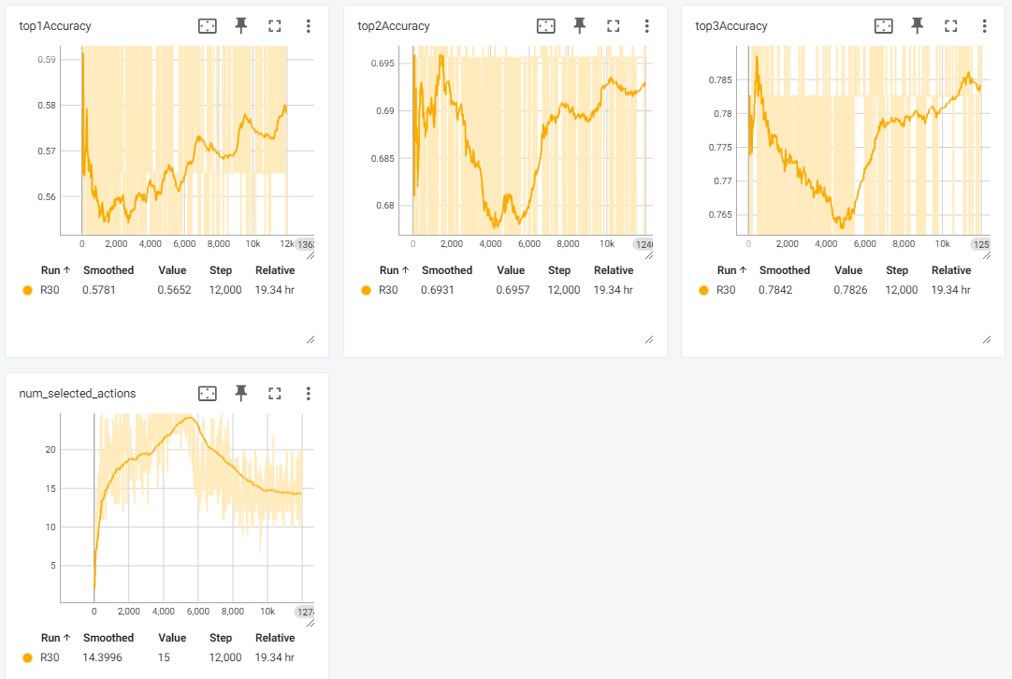
RL Results
Multiplication-Model

Slide 17
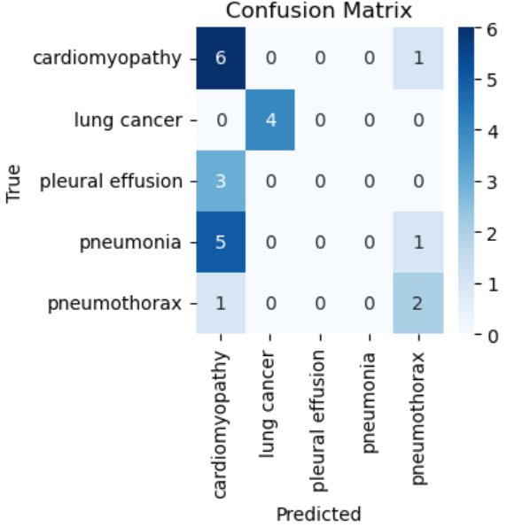
RL Results
Multiplication-Model

Slide 18
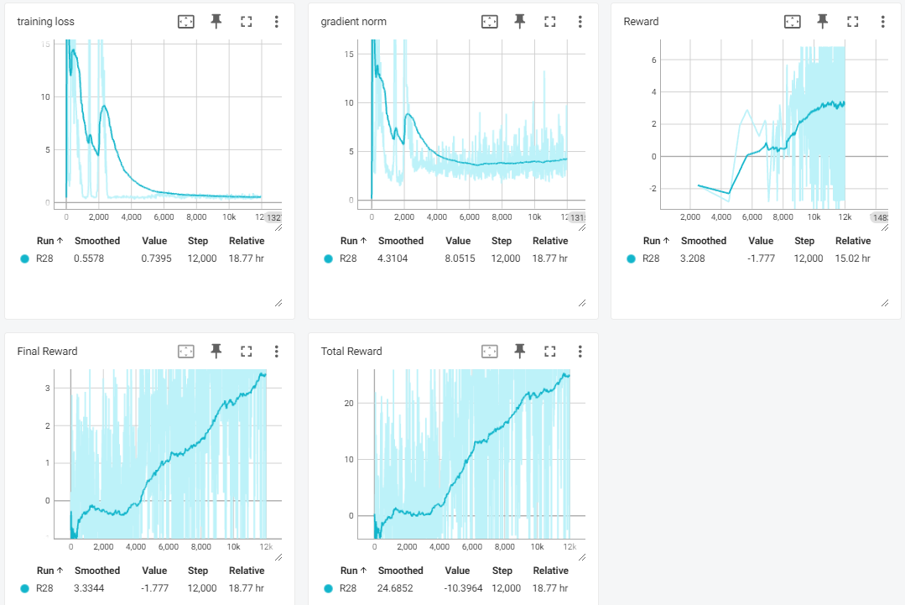
RL Results
Addition-Model

Slide 19
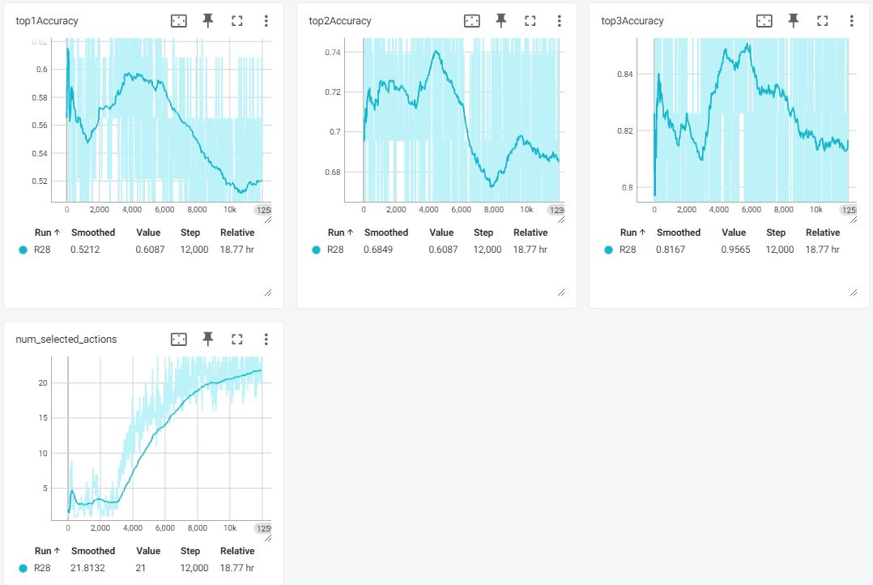
RL Results
Addition-Model

Slide 20
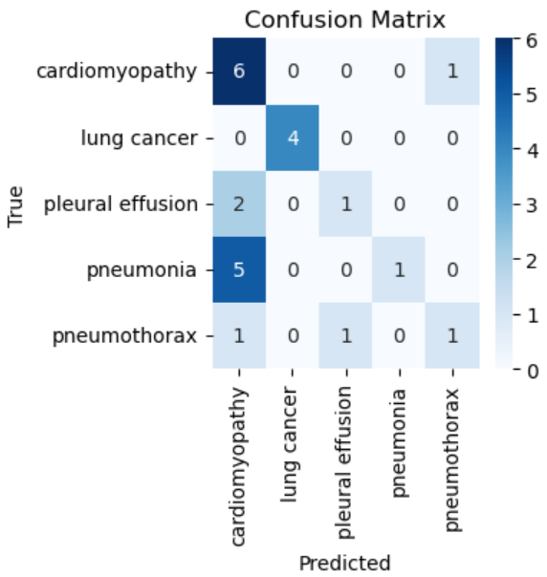
RL Results
Addition-Model

Slide 21
RL Results
Top-K Accuracy
Multiplication-Model | Top-1 | 0.49
 | Top-2 | 0.71
 | Top-3 | 0.88
Addition-Model | Top-1 | 0.51
 | Top-2 | 0.75
 | Top-3 | 0.87
Untrained-Model (CNN only) | Top-1 | 0.49
 | Top-2 | 0.73
 | Top-3 | 0.87
Table: Mean Top-K-Accuracy for 100 iterations

Slide 22
Discussion
Both models could reduce loss i.e. learn action-values
Neither made significant progress in top-k accuracy on the evaluation set
Multiplication-Model could increase the Reward a little bit
Assumption: model learns which actions doesn’t decrease the posterior and then just takes these actions
Addition-Model could increase the reward significantly
But still no progress on the Top-K-Accuracy Evaluation
Notes:
We assume the model learns which actions doesn’t decrease the posterior and then just takes these actions -> reward is prior.
The Addition-Model could increase the reward significantly, but there was still no progress on the Top-K-Accuracy Evaluation. This surprised us a little. We would have expected that it would increase. This either means that our approach is wrong, that the model can't learn enough from the training data, or that there is a bug in the code that we haven't discovered yet. We could also be unlucky with our train-test-split. A better approach would be cross-validation, but this would increase the training time by a multiple of the number of foldings.
The oscillations of the rewards and the Top-K-Accuracies are also striking. However, we do not think that this is an abnormality, but an expected behaviour.

Slide 23
Encountered problems
The patient was asked the same symptom multiple times
Debugging of problems is hard and time consuming
Speed of training resulting in training time limitations

Slide 24
Attempted but discarded approaches
Optimistic initialization
Exponential epsilon decay

Slide 25
Open Questions
How did the original paper use a reward function which multiplies the conditional probabilities?
Which parameters did original paper used for Epsilon, Tau etc.
How to handle train-test split to train two networks?
CNN needs train-test split
How should RL be trained?
With too accurace train split and evaluation on test split?
Split CNN test split in train and test split?
Notes:
«miscarriage» example where addition > 1
In this case we would need another split as test split for the RL model. This would decrease the Trainingset for the CNN and the RL model. If we then add a validation set for both trainings, it gets even worse. In the original paper they mentioned that they used a train-val-test split for the CNN but it’s not clearly described how the split the data for the RL model.

Slide 26
Many thanks for your attention

